Slide 1
Microsoft Office Specialist Certification
A Way to Stand Out

Slide 2
Why should you become Certified?
Universally recognized certification offered by Certiport.
Certification proves to potential employers that you understand Microsoft Office products.
According to a 2008 survey, “89% of supervisors say that Microsoft Office certified employees are more proficient users of Microsoft Office programs.”¹
¹Making the Difference. www.cyberlearningindia.com. 2009. Web. 26 Feb 2013.

Slide 3
Microsoft Office Specialist (MOS) Exams
There are nine available exams covering seven Microsoft Office products.
For a list of all Microsoft software exams, see information on Certiport’s MOS exams.

Slide 4
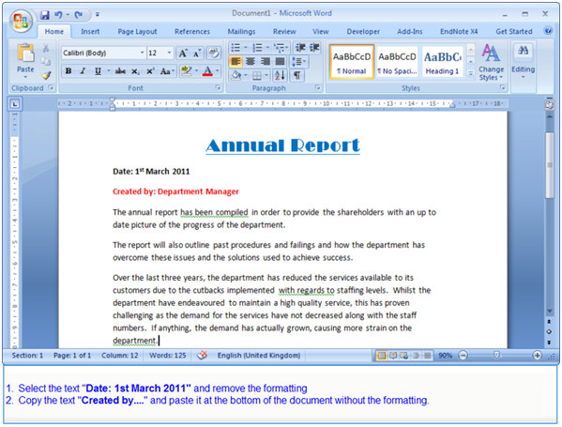
Exam Details
Certifications never expire.
You receive immediate results.
If you fail, you must wait at least seven days to retake the exam.
Because tests are varied, there is no set score that you must obtain to pass an exam.
IMAGE 5.1
You can find more information on question formats on Microsoft’s website.

Slide 5
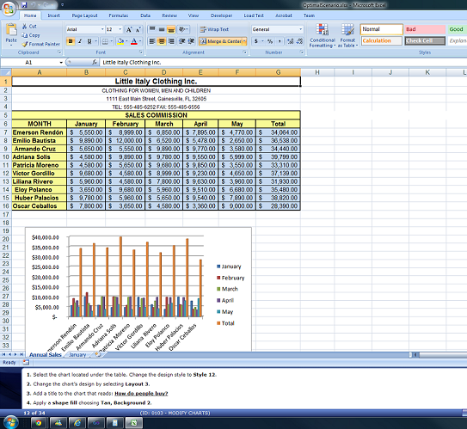
Exam Format
Questions include a variety of formats.
Different exams have different numbers of questions. For example, Excel 2010 has 20 questions.
Exams must be completed within 50 minutes.
There is no penalty for guessing
IMAGE 6.1
You can find more information on question formats on Microsoft’s website.

Slide 6
Levels of Certification
Microsoft Office Master
Once you pass the Word and Excel expert tests, the PowerPoint specialist test, AND one other test, you receive the Microsoft Office Master designation.
Microsoft Office Expert
Expert certification is available only for Word and Excel. These are exams like the specialist exams, only harder.
Microsoft Office Specialist
You earn Microsoft Office Specialist (MOS) status for each exam you pass. For example, once you pass the Microsoft Access test, you are a Microsoft Office Access Specialist.
See Certiport’s explanation of Microsoft Office certification levels.

Slide 7
Where to take the exams
IUPUI students are offered a discounted rate if they choose to take the exams on campus.
$70 per exam
Take the exams at the Informatics and Communications Complex (IT Building) on campus.
You must register at least 2 weeks in advance.
IT Training does not yet offer
MOS 2013 exams.
.
IMAGE 8.1
See other locations at Certiport’s Testing Center Locator.

Slide 8
MOS 2010 Exams
This presentation will focus on MOS 2010 certifications. Specifically, you will find information on exams for the four main office applications:
Microsoft Word
Microsoft Excel
Microsoft PowerPoint
Microsoft Access
For a list of all Microsoft Specialist exams, see information on Certiport’s MOS exams.

Slide 9
Word 2010 Skills Tested
Apply document views
Share/Protect documents
Manage document versions/drafts
Search documents
Use templates, themes, Quick Parts
Insert page backgrounds
Format pictures, captions, screenshots
Customize AutoCorrect
Create Table of Contents
Use Mail merge
Places | Notes | Things
Seattle | Something | Amazing
Montreal | Something | Gorgeous
California | Something | Special
See comprehensive skills lists for the Word 2010 exam.

Slide 10
Word 2010 Expert Skills Tested
Word 2010 skills PLUS
Configure default program options
Create templates
Make chart templates
Link text boxes and sections
Create Quick Parts
Apply Tracking
Manage comments
Create document index
Manage macros
Manipulate forms
See comprehensive skills lists for the Word 2010 Expert exam.

Slide 11
Excel 2010 Skills Tested
Early Rock
Blues
Traditional Country
Use Hot keys (keyboard shortcuts)
Apply Print settings
Customize settings using backstage
Manipulate views and sharing
Insert formulas (including named ranges, order of operations, etc.)
Create and modify charts, images, and Sparklines
Manage Comments
Apply formatting (including conditional)
Folk
See comprehensive skills lists for the Excel 2010 exam.

Slide 12
Excel 2010 Expert Skills Tested
Majors | Current Enrollment
PowerPoint | 20
Word | 50
Excel | 70
IMAGE 13.1
See comprehensive skills lists for the Excel 2010 Expert exam.

Slide 13
PowerPoint 2010 Skills Tested
Adjust views
Configure Quick Access toolbar
Create and edit Photo albums
Set up slide footers
Format text boxes by wrapping text, applying columns, and inserting internal margins
Manipulate images
Edit video and audio
Manage tables and charts
Apply animation and timing
Manage comments
Share, Print, and Protect presentations
Use pen and highlighter
Play narration
Record shows
See comprehensive skills lists for the PowerPoint 2010 exam.

Slide 14
Access 2010 Skills Tested
Configure Navigation Pane
Use Blank Forms, Quick Start, and user templates
Create and Modify tables and fields
Sort and Filter records
Apply relationships and primary key
Import data
Create and Design forms, queries, and reports
Arrange and Format forms, queries, and reports
Perform calculations in queries
Use Total and Group By rows in queries
Apply themes, header and footer, background images, and conditional formatting to reports.
See comprehensive skills list for the Access 2010 exam.

Slide 15
Skills on Excel exams not taught in K201
Excel
Excel Expert
Hot Keys
Customize Quick Access toolbar and ribbons/tabs.
Import to and export to and from Excel.
Preview icons
Apply coloring to worksheet tabs
Workbook views
Edit images
Send a worksheet via email or skydrive
Excel 2010 skills PLUS
Export XML data
Track document changes
Disable automatic calculation
Manipulate forms
See comprehensive skills lists for the Excel 2010 and Excel 2010 Expert exams.

Slide 16
Skills on Access exam not taught in K201
Configure Navigation Pane
Apply background images to reports.
See comprehensive skills list for the Access 2010 exam.

Slide 17
Microsoft Office 2013 Exams
Certiport has begun releasing MOS 2013 exams, but they will not all be available until 2014.
MOS 2013 exams will focus on asking the exam taker to complete projects/tasks rather than individual questions, as in 2010 exams.
Microsoft Office 2013 is very similar to Office 2010.
See scheduled 2013 exam release dates or what’s new in Microsoft Office 2013.

Slide 18
Why Business Students should become certified in Excel and Access
Over 90% of businesses use Microsoft Office.¹
Proves your proficiency
Certiport certification is recognized by employers
Certification shows you are serious about demonstrating your Office skills.
Reinforces your knowledge of crucial software
Passing requires advanced understanding of the applications.
Preparing for the test gives you additional practice to help you remember the needed skills.
⁺Silver, Michael. “Google's QuickOffice Buy Pressures Microsoft Mobile Office Pricing.” Gartner research. 12 June, 2012. Web. 8 April, 2013.

Slide 19
Appendix
For more information on the Microsoft Office Specialist (MOS) exams:
Certiport’s website
Microsoft’s website
Free Microsoft Office training available to IUPUI students:
IUPUI’s IT Training
Image 5.1: Found at <http://iss.leeds.ac.uk/faqs/260/itis_training/answer/1220/what_is_the_format_of_the_microsoft_office_specialist_exams>
Image 6.1: Found at <http://www.gmetrix.com/>
Image 8.1: Found at http://www.iupui.edu/buildings/IT

